Slide 1


PHP Development Course
MEC Academy

Slide 2
Agenda
If
If else
If elseif else
Nested if
Switch
While loop
Do while
For loop
Dependencies
&
Issues / Risks
Schedule (High Level)
Completed Activities
Timeline
Action
Items
Change Requests

Slide 3
01
PHP If Else

Slide 4
PHP If Statement
PHP if statement allows conditional execution of code. It is executed if condition is true.
If statement is used to executes the block of code exist inside the if statement only if the specified condition is true

Slide 5
Syntax
if (condition) {
code to be executed if this condition is true;
} elseif (condition) {
code to be executed if first condition is false and this condition is true;
} else {
code to be executed if all conditions are false;
}

Slide 6
02
PHP Switch

Slide 7
PHP switch statement
PHP switch statement is used to execute one statement from multiple conditions.
It works like PHP if-else-if statement.

Slide 8
Syntax
switch(expression){
case value1:
//code to be executed
break;
case value2:
//code to be executed
break;
......
default:
//code to be executed if all cases are not matched;
}

Slide 9
notice
The default is an optional statement. Even it is not important, that default must always be the last statement.
There can be only one default in a switch statement. More than one default may lead to a Fatal error.
Each case can have a break statement, which is used to terminate the sequence of statement.
The break statement is optional to use in switch. If break is not used, all the statements will execute after finding matched case value.
PHP allows you to use number, character, string, as well as functions in switch expression.

Slide 10
03
PHP For Loop

Slide 11
PHP For Loop
PHP for loop can be used to traverse set of code for the specified number of times.
It should be used if the number of iterations is known otherwise use while loop. This means for loop is used when you already know how many times you want to execute a block of code.

Slide 12
Syntax
for
(
initialization;condition;inc/dec
)
{
//code to be executed
}

Slide 13
PHP For Loop - Parameters
initialization : Initialize the loop counter value. The initial value of the for loop is done only once. This parameter is optional.
condition : Evaluate each iteration value. The loop continuously executes until the condition is false. If TRUE, the loop execution continues, otherwise the execution of the loop ends.
Increment/decrement : It increments or decrements the value of the variable.

Slide 14
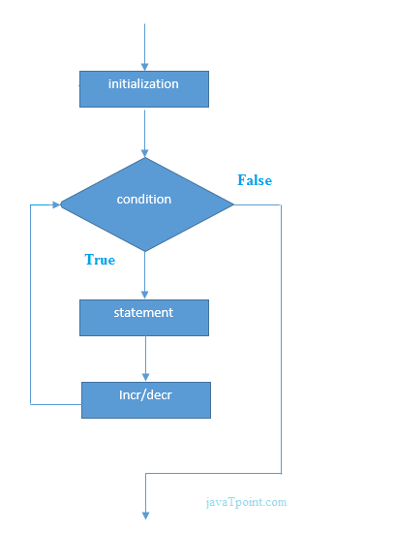
PHP For Loop

Slide 15
PHP foreach loop
The foreach loop is used to traverse the array elements. It works only on array and object. It will issue an error if you try to use it with the variables of different datatype.
The foreach loop works on elements basis rather than index. It provides an easiest way to iterate the elements of an array

Slide 16
Syntax
foreach ($array as $value) {
//code to be executed
}

Slide 17
04
PHP While Loop

Slide 18
PHP While Loop
PHP while loop can be used to traverse set of code like for loop. The while loop executes a block of code repeatedly until the condition is FALSE. Once the condition gets FALSE, it exits from the body of loop.
It should be used if the number of iterations is not known.

Slide 19
Syntax
while(condition){
//code to be executed
}

Slide 20
PHP do-while loop
PHP do-while loop can be used to traverse set of code like php while loop. The PHP do-while loop is guaranteed to run at least once.
The PHP do-while loop is used to execute a set of code of the program several times. If you have to execute the loop at least once and the number of iterations is not even fixed, it is recommended to use the do-while loop.
It executes the code at least one time always because the condition is checked after executing the code.
The do-while loop is very much similar to the while loop except the condition check. The main difference between both loops is that while loop checks the condition at the beginning, whereas do-while loop checks the condition at the end of the loop.

Slide 21
Syntax
do{
//code to be executed
}
while(condition);

Slide 22
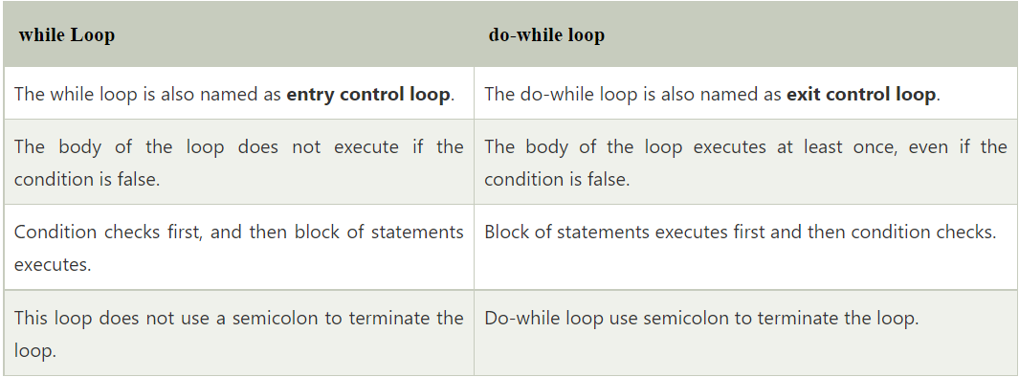
Difference between while and do-while loop

Slide 23
Any Questions?

